Slide 1
Management and Governance Services

Slide 2



AWS Management & Governance Services
AWS CloudTrail
AWS
CloudFormation
Amazon CloudWatch

Slide 3

Reviewing the ecosystem of services that are provided for management
Examining how to create an audit trail with AWS CloudTrail
Exploring how you track infrastructure with CloudWatch Introducing infrastructure automation with CloudFormation
Overview

Slide 4
AWS CloudTrail

Slide 5
“With CloudTrail, you can log, continuously monitor, and retain account activity related to actions across your AWS infrastructure.
CloudTrail provides event history of your AWS account activity, including actions taken through the AWS Management Console, AWS SDKs, command line tools, and other AWS services.”
Amazon Web Services

Slide 6
AWS CloudTrail
Inserts audit trail in an S3 bucket or into CloudWatch Logs
Logs events in the regions in which they occur
Meets many compliance requirements for infrastructure auditing
As a best practice, it should be enabled on every AWS account
Can be consolidated into an Organizational trail using AWS Organizations

Slide 7
Compliance requirement
Forensic analysis Operational analysis Troubleshooting
AWS CloudTrail Use Cases

Slide 8
Amazon CloudWatch

Slide 9
Managing Infrastructure
Amazon CloudWatch
Provides metrics, logs, and alarms for infrastructure

Slide 10

Amazon CloudWatch
Monitoring and management service
Collects logs, metrics, and events from most AWS services
Enables alarms based on metrics
Provides visualization capabilities for metrics
Allows for custom dashboards based on collected metrics

Slide 11
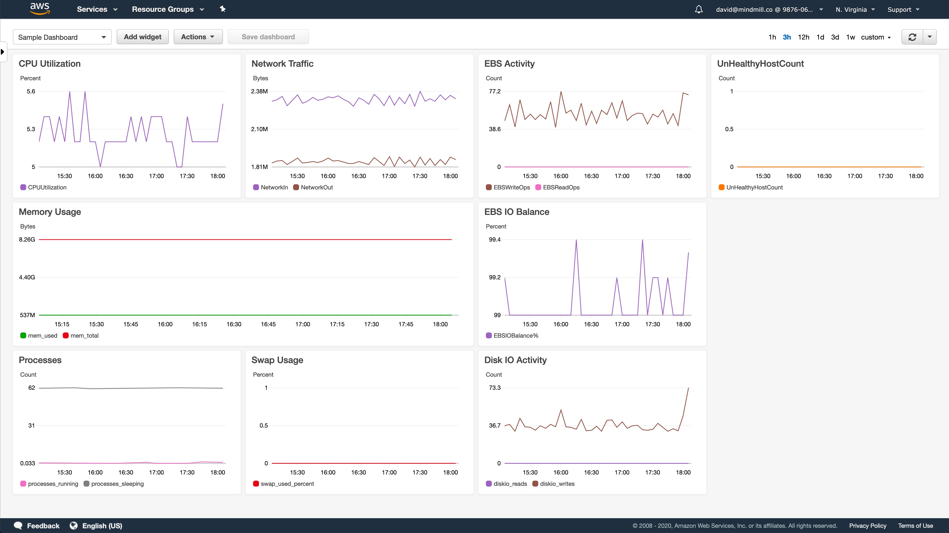

Slide 12
AWS CloudFormation

Slide 13
AWS CloudFormation
Managed service for provisioning infrastructure based on templates
No additional charge
Templates can be YAML or JSON Enables infrastructure as code
Manages dependencies between resources
Provides drift detection to find changes in your infrastructure

Slide 14
Description: Creates an S3 bucket
Resources: SampleS3Bucket:
Type: AWS::S3::Bucket Properties:
BucketName: sample-s3-bucket
Example CloudFormation YAML
The code above if placed within a full CloudFormation template would create a single S3 bucket

Slide 15
Scenario Based Review

Slide 16

Scenario 1
James is the lead architect at a SaaS company
They will be launching a new application that includes several components
He is looking to minimize manual work required when creating infrastructure
What service would enable James to automate much of this effort?

Slide 17

Scenario 2
Candace is the CTO at a manufacturing company
A cloud server needed to support their manufacturing process was deleted
They want to make sure the follow up with the person who deleted this instance
Which service could show the individual that deleted this specific server?

Slide 18
Summary

Slide 19
Reviewed the ecosystem of services that are provided for management
Examined how to create an audit trail with AWS CloudTrail
Explored how you track infrastructure with CloudWatch Introduced infrastructure automation with CloudFormation
Summary

Slide 20
Scenario 1
James is the lead architect at a SaaS company
They will be launching a new application that includes several components
He is looking to minimize manual work required when creating infrastructure
What service would enable James to automate much of this effort?
Solution: AWS CloudFormation

Slide 21
Scenario 2
Candace is the CTO at a manufacturing company
A cloud server needed to support their manufacturing process was deleted
They want to make sure the follow up with the person who deleted this instance
Which service could show the individual that deleted this specific server?
Solution: AWS CloudTrail

